Slide 1

Herakles
Martin Schicklgruber
Nora Wokatsch
Marlies Hüttner
Notes:
Mali

Slide 2
platform
Android
minSdkVersion 21 (5.0)
Devices for testing
Nexus 5X (8.0.0)
Samsung Galaxy S4 mini
Lenovo Moto G5 Plus (7.0)
Sony Xperia Z (5.2.2)
Android Studio 3.0
Notes:
Mali

Slide 3
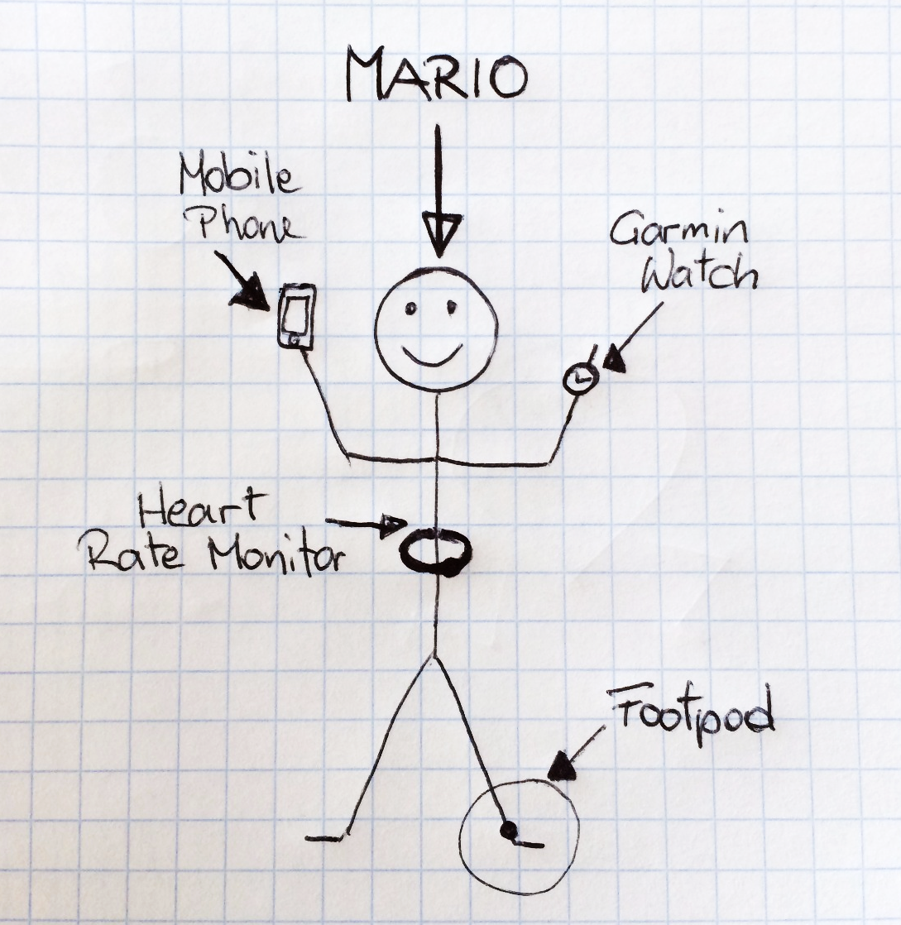
Scenario
Mario‘s Devices
Mobile Phone
Garmin Watch
Heart Rate Monitor
Footpod
Notes:
Nora

Slide 4
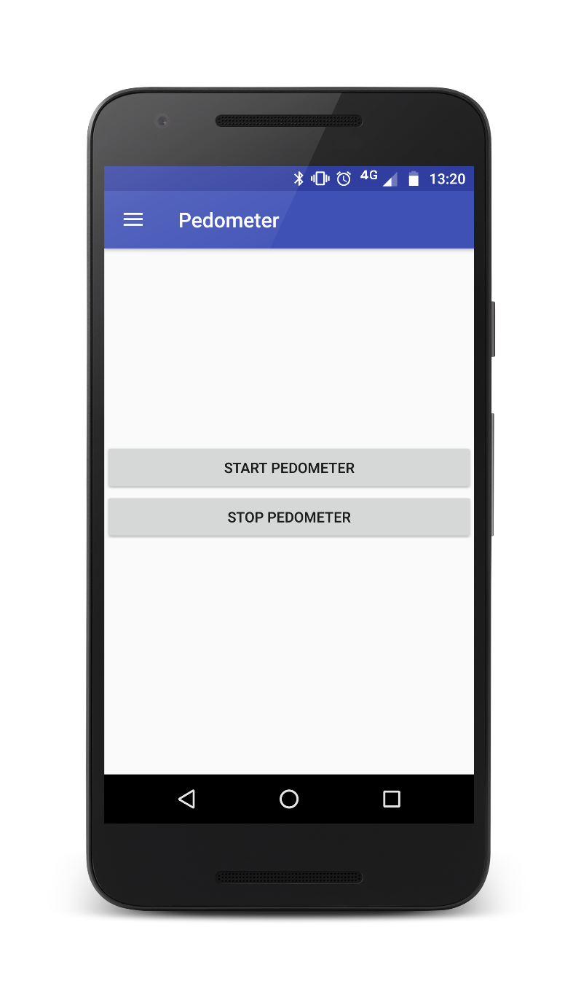
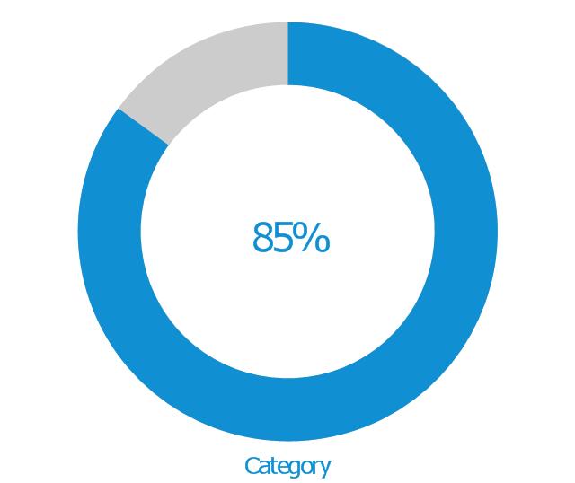
Pedometer
count steps (mobile phone)
save data on server
every 24 h
should run in background
step goal
user defined
notification when step goal is reached
nice visualisation in app
Goal: 3000 steps
2550 Steps
Notes:
Nora

Slide 5
planning of work packages + effort estimation
count steps
service
6 h
server connection
Firebase
save data every 24 h (steps per day)
5h
visualisation
3 h
Notes:
Schicki

Slide 6
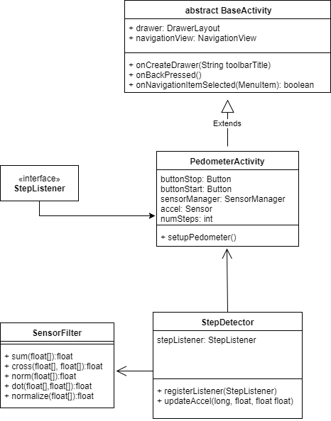
Architecture
Notes:
Schicki

Slide 7
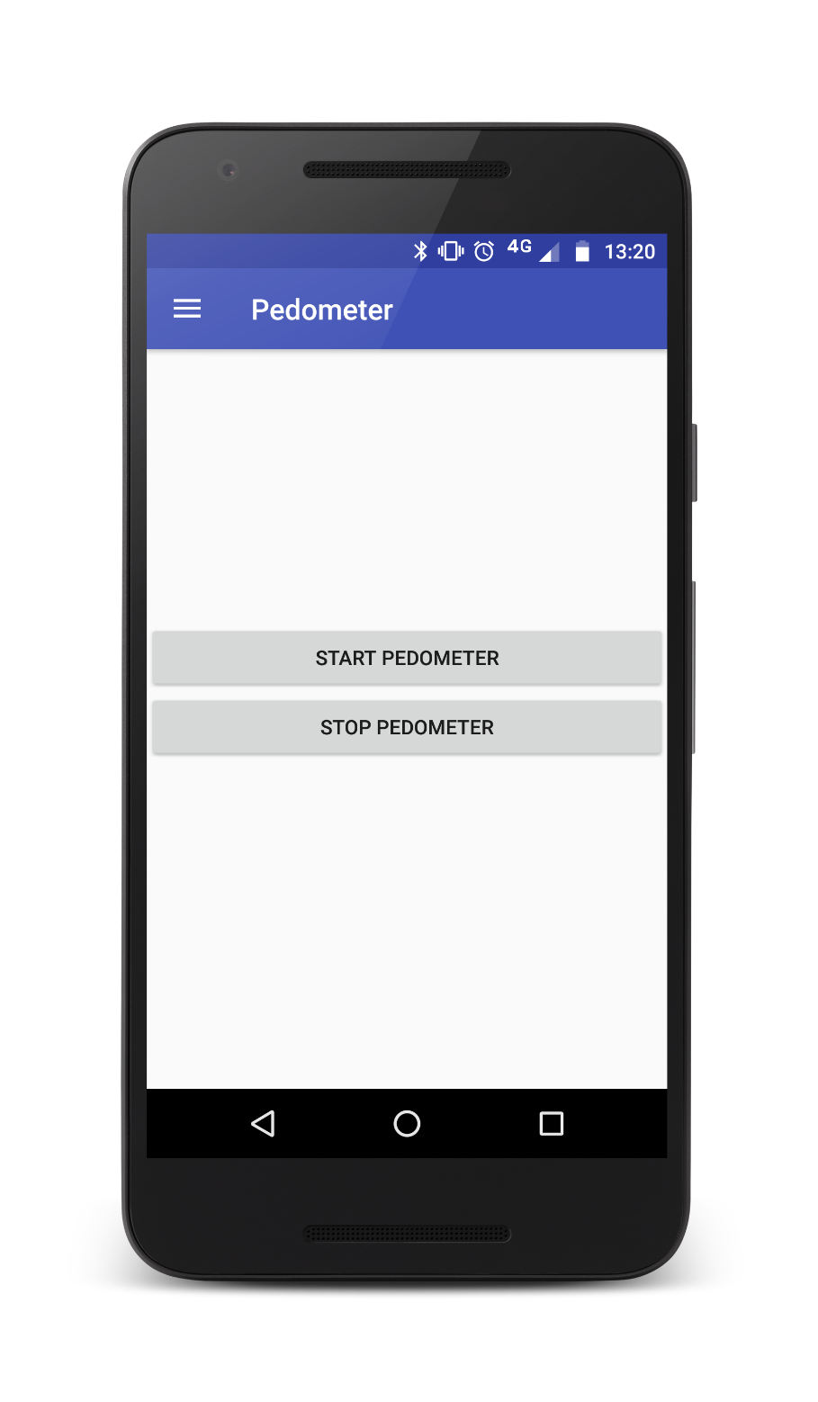

Status Report
Notes:
Mali

